Slide 1


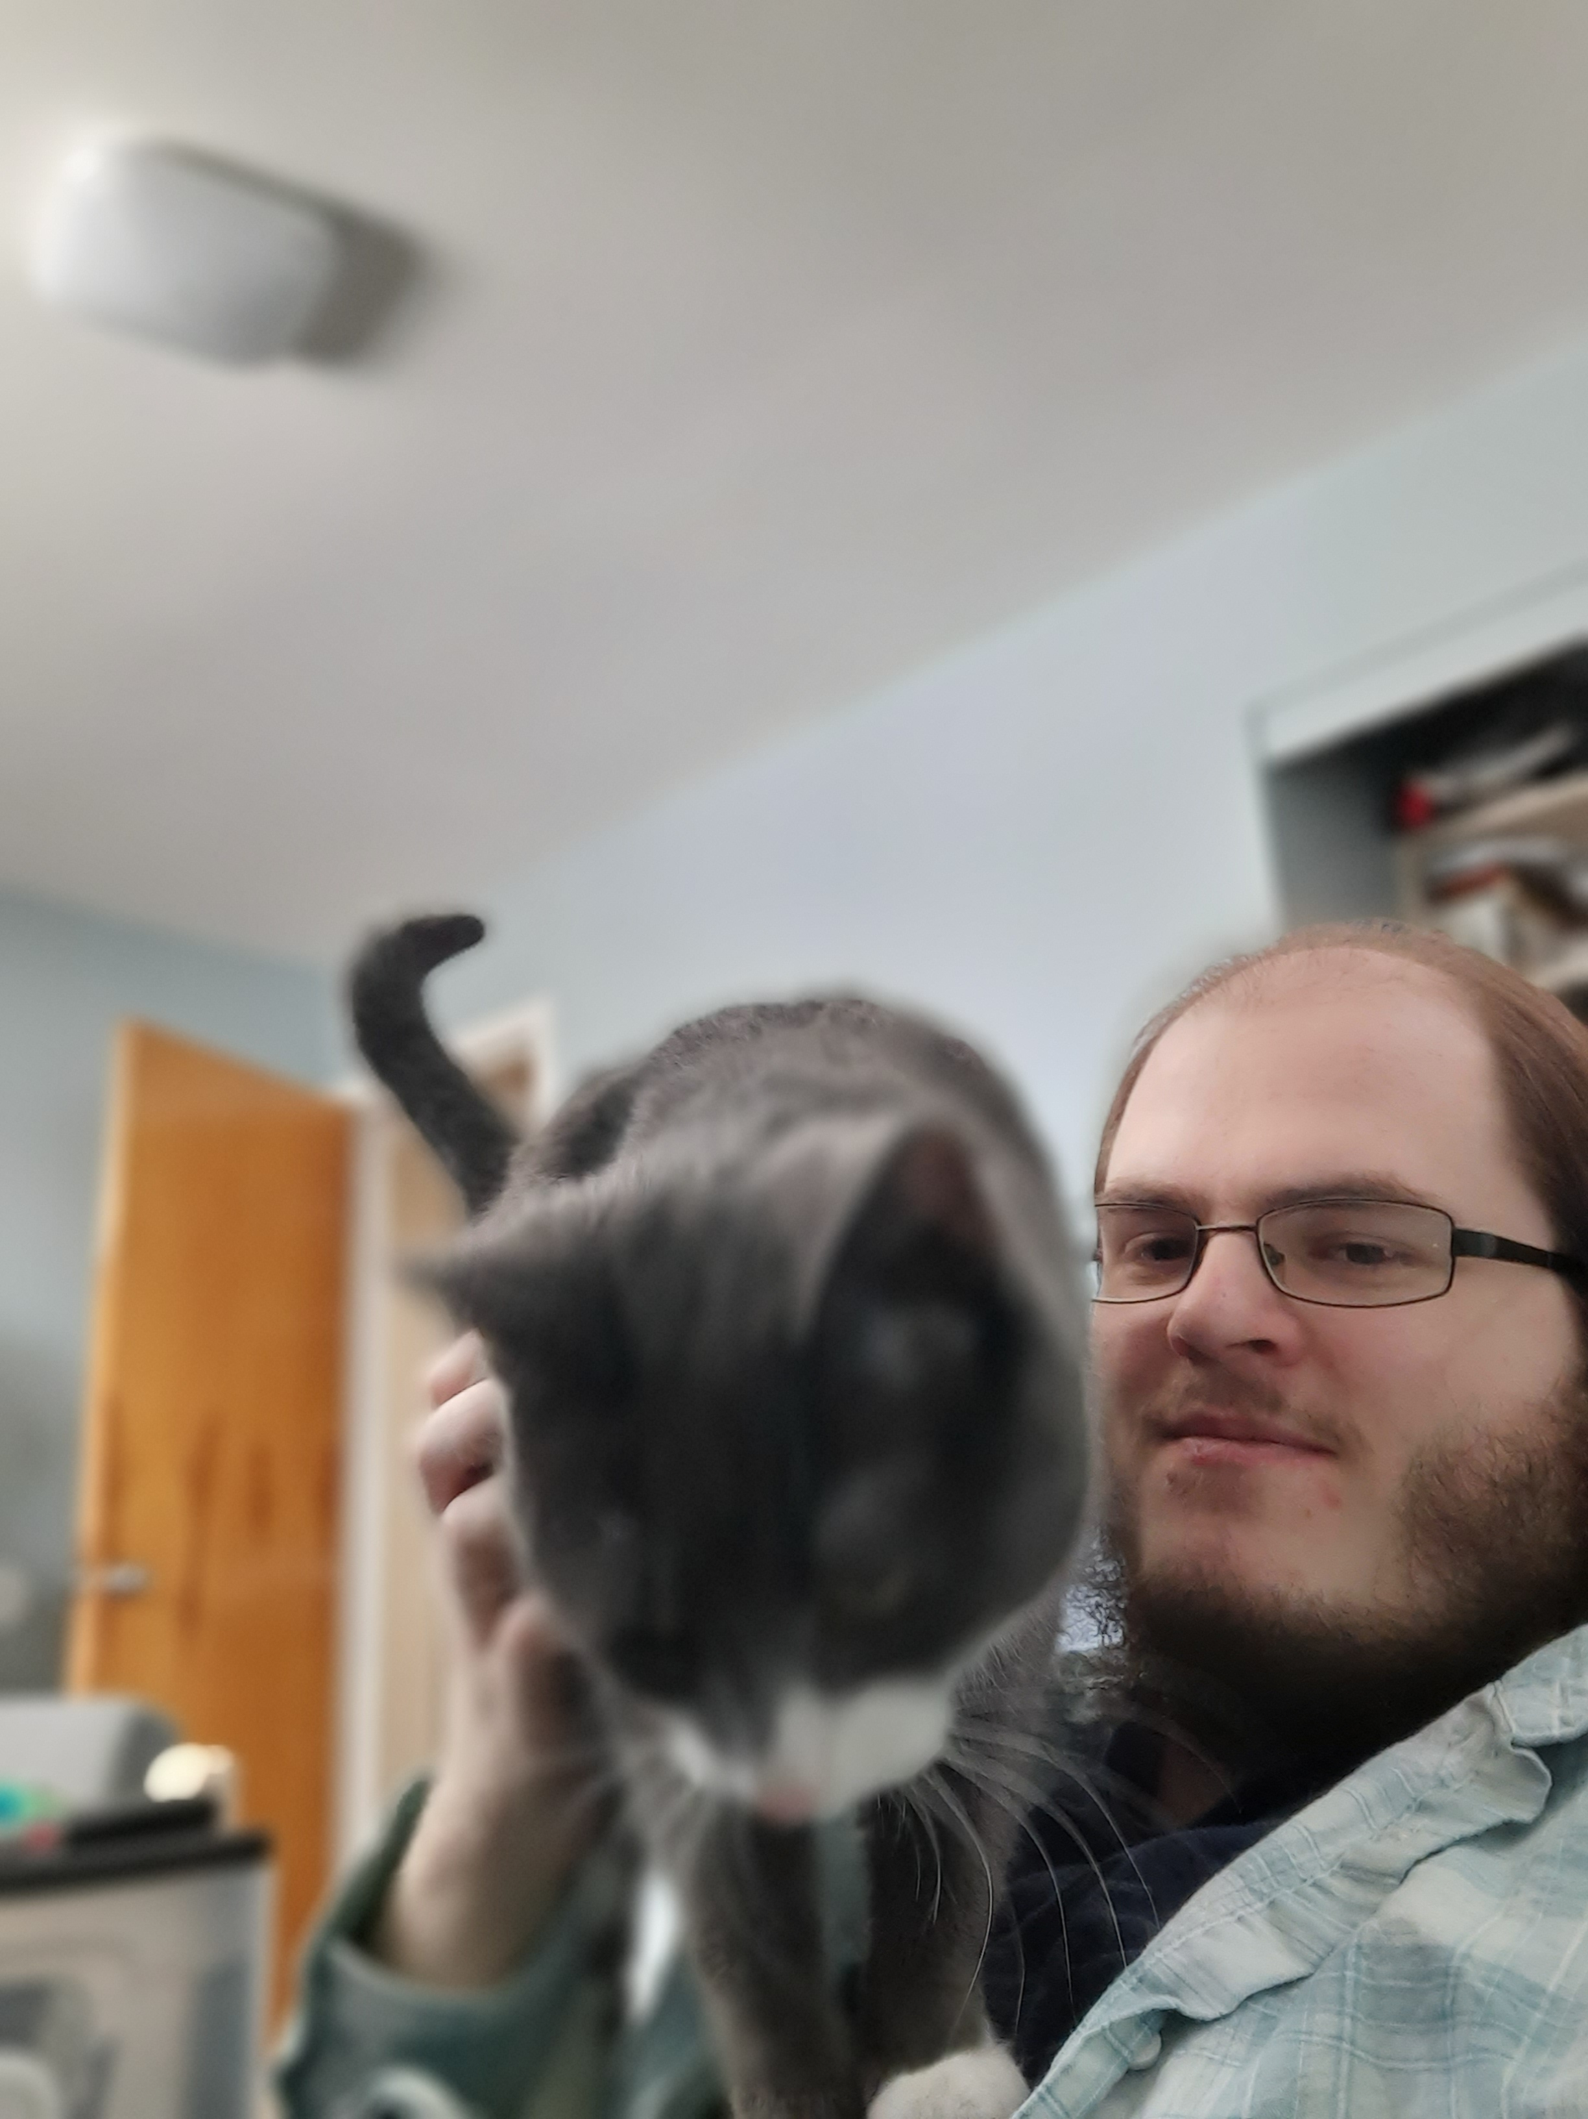
Recent New Hires
Welcome new hire David Perry
Position Title
Current: Software Engineer
Previous:
Software Engineer (Revspring/Optomi)
Embedded Software Engineer (General Dynamics Land Systems/Softworld)
Junior Software Developer (Atlas Copco)
Work Experience
4 months, Atlas Copco, Sterling Heights, MI
1 year, General Dynamics Land Systems, Sterling Heights, MI
6 months, Revspring, Livonia, MI
Education
BS in Computer Science at Lawrence Technological University
Minor in Mathematics at Lawrence Technological University
Hobbies / Interests / Family
Reading, cooking, card/board/video games

